Slide 1
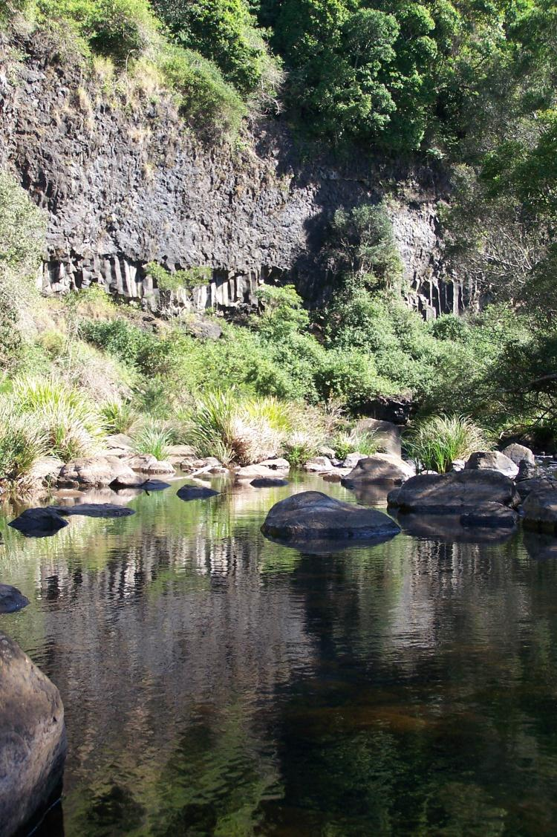
Lake Baroon Catchment Care Group
Project Manager
Report
June 19, 2014

Slide 2
All current Projects
Number | Project Name | Status | Allocated 2013-14 | Other Income | Expenditure since last meeting | Expenditure 2013-14
0708-005 | Upper Small Creek Rehabilitation Project | Reveg. maint.; weed mgt (madiera) |  |  | $ 385.00 | $ 4,273.64
0809-001 | Walkers Creek Restoration Stage 1 | Reveg. maint.; sign |  |  | $ - | $ 654.50
0809-005 | Rob Cork Dairy Pad Project | Completed (signage budget) |  |  | $ - | $ -
0910-010 | Upper Obi Obi Creek Frontage Plan | Completed |  |  |  | $ 625.36
1011-003 | Arley Creek Wetlands Project Year 2 | OSW |  |  | $ 596.36 | $ 596.36
1011-005 | Upper Obi Obi Creek Restoration | Completed (see 1314-005) |  |  |  | $ 1,090.00
1011-011 | Willow Creek Stormwater Project | Maint.; SUSPENDED |  |  |  | $ 1,840.00
1112-003 | Bridge Creek Riparian Remnant Fencing | Materials purchased. |  |  |  | $ 3,745.45
1112-005 | Upper Obi Obi Creek Restoration | Completed (see 1314-005) |  |  |  | $ 4,130.00
1112-009 | Cork Dairies Obi Obi Creek Riparian Protection | Completed (reconcile budgets) |  |  |  | $ 5,417.00
1213-001 | MCP Riparian Revegetation Fencing Stage 2 & 2B | Completed |  |  |  | $ 4,573.15
1213-002 | Upper Lawley Creek Restoration Year 2 | Reveg. maint.; OSW & crossing maint. |  |  |  | $ 2,007.25
1213-003 | Restoring Bridge Creek | Reveg. maint.; replanting |  |  | $ 2,694.21 | $ 5,710.13
1213-005 | Upper Obi Obi Creek Restoration Year 2 | Completed (see 1314-005) |  |  | $ 245.00 | $ 3,431.18
1213-007 | Bridge Creek Rehabilitation (Watter) | Completed (reconcile budgets) |  |  | $ - | $ 420.00
1213-008 | Erowal Riparian Fencing & Off Stream Watering | Fencing completed; weed mgt pending |  |  | $ 665.00 | $ 16,569.54
1213-009 | Upper Alcorn Creek Riparian Fencing | All on ground activities completed. |  |  |  | $ 40,698.00
1213-010 | Spiny Crayfish Research | NON-SEQWATER PROJECT; Year 2 funding |  |  |  | $ 5,000.00
1213-012 | Alcorn Creek Riparian Remediation | Minor maintenance req. |  | $ 7,975.50 |  | $ 11,730.00
1314-000 | Unallocated projects |  | $ - |  | $ 854.55 | $ 1,214.55
1314-001 | MCP Riparian Revegetation Fencing Stage 3 | Fencing materials ordered | $ 6,930.00 |  | $ 1,994.85 | $ 6,416.91
1314-002 | Upper Lawley Creek Restoration Year 3 | Maintenance | $ 5,080.00
1314-003 | Restoring Bridge Creek Year 2 | Maintenance | $ 6,716.00
1314-005 | Upper Obi Obi Creek Restoration Year 3 | Maintenance | $ 6,000.00
1314-006 | Walkers Creek Restoration Stage 2 | Completed | $ 15,750.00 |  |  | $ 15,750.00
1314-008 | Erowal Riparian Fencing & OSW Stage 2 | Weed maintenance continuing | $ 11,855.00 |  |  | $ 4,984.61
1314-009 | Cavanagh - 2013-14 Seqwater Landslide Program | Completed | $ 13,272.00 |  | $ 669.00 | $ 12,574.18
1314-011 | Ling Landslip Remediation | Completed - Invoice BMRG | $ 7,881.00 | $ 2,500.00 | $ 2,032.80 | $ 11,361.34
1314-010 | Wittacork - 2013-14 Seqwater Landslide Program | Commencement imminent | $ 17,640.00 |  | $ 8,789.08 | $ 8,789.08
1314-017 | Mid Obi Riparian Corridor | Plan completed | $ 29,166.00 |  | $ 1,192.72 | $ 1,839.52
1314-018 | Landslide Remediation Program |  |  | $ 39,402.00 | $ 17,370.00 | $ 17,370.00
Totals |  |  | $ 120,290.00 | $ 10,475.50 | $ 37,488.57 | $ 192,811.75

Slide 3
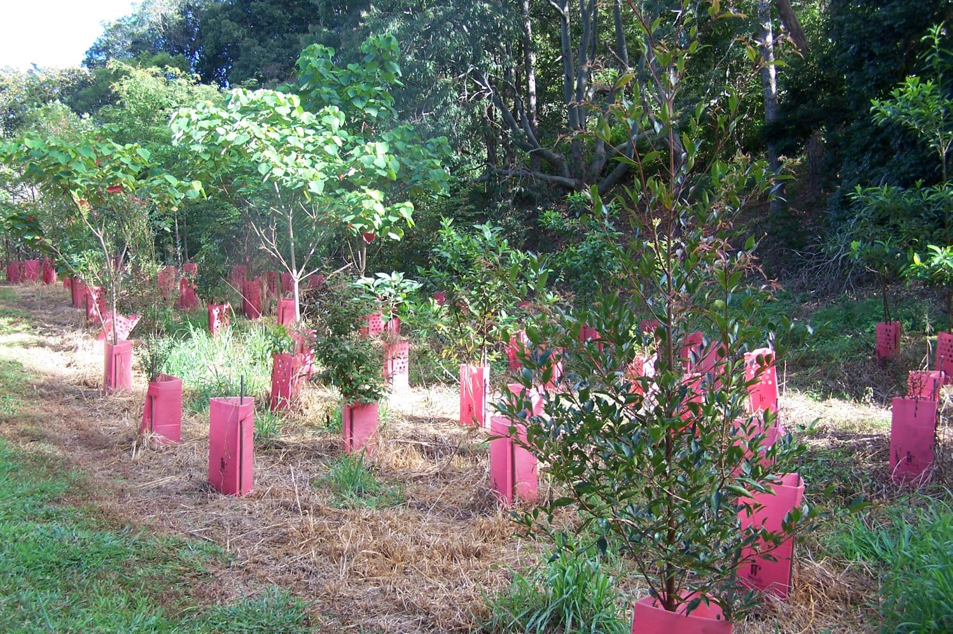
Projects – Upper Smalls Creek
Weed management (madeira vine, other env. weeds)
Replanting (30 blackwood)

Slide 4
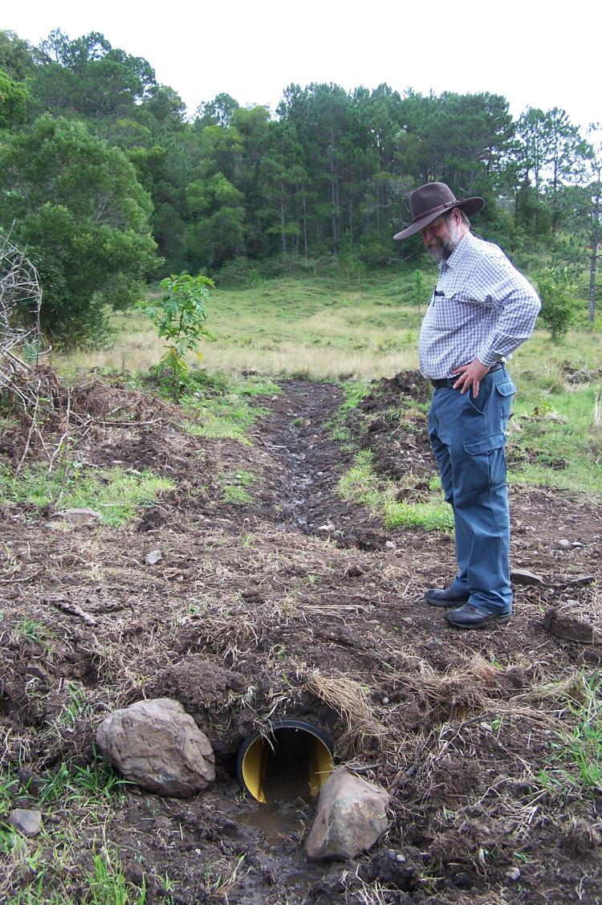
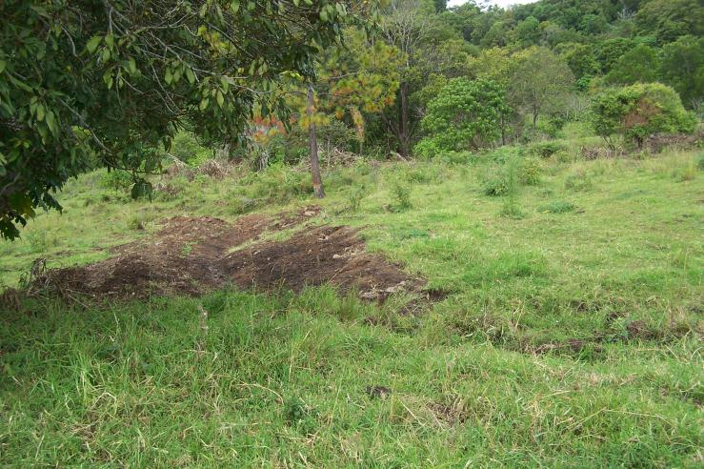
Projects – Ling Landslip Remediation
Commenced drainage works (pictured is John Day BMRG Soil Conservation officer).
Activities will redirect surface flows away from unstable landslip on neighbouring (Ling) property and into existing watercourses.

Slide 5
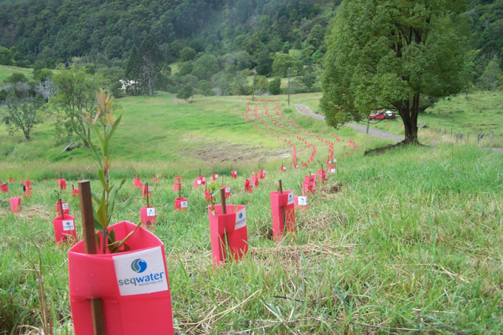
Projects – Ling Landslip Remediation
Field Walk speakers & guests include
Ashley Sewell
Jess Trofimovs & Will Stearman (QUT)
Dave Clark (Maroochy FARMflow)
Tim Odgers (Seqwater)
Alan Wynn (Sunshine Coast Council)
Warwick Willmott (Geological Society – Qld)
John Day (BMRG)
Kay Enkelmann (BMRG)
Nambour TAFE

Slide 6
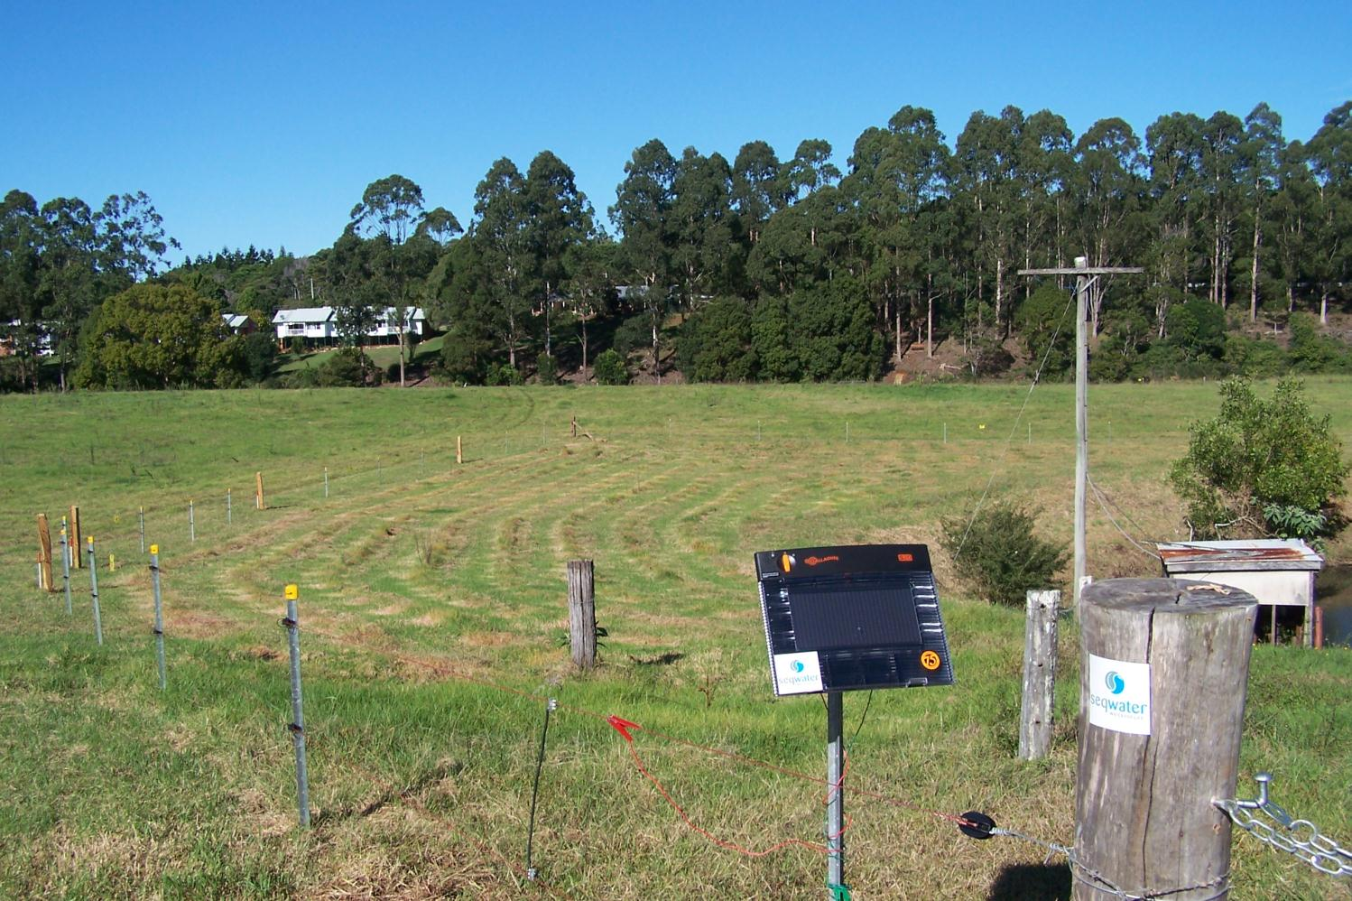
Projects – Maleny Community Precinct
Revegetation Fencing Stage 3
850 metres semi-permanent electric fencing

Slide 7
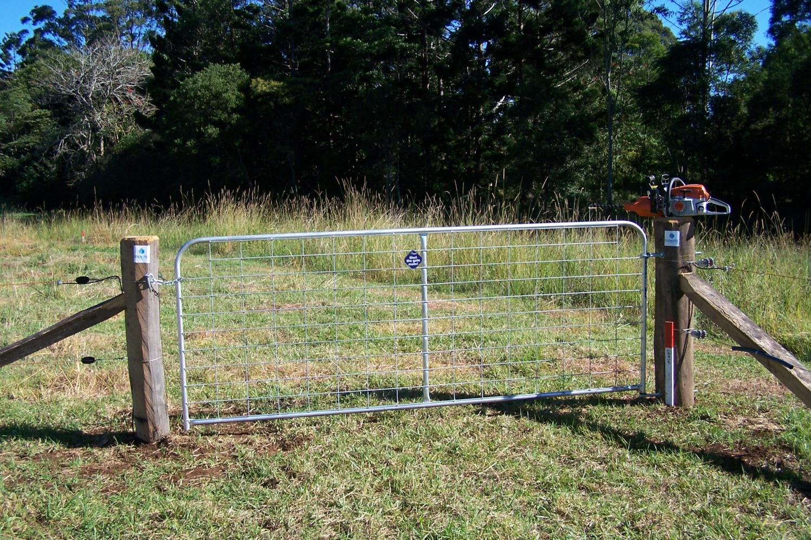
Projects – Maleny Community Precinct
Revegetation Fencing Stage 3
Utilised BMRG-funded chainsaw/post hole borer (pictured on strainer post)
Project a training exercise for CVA supervisor

Slide 8
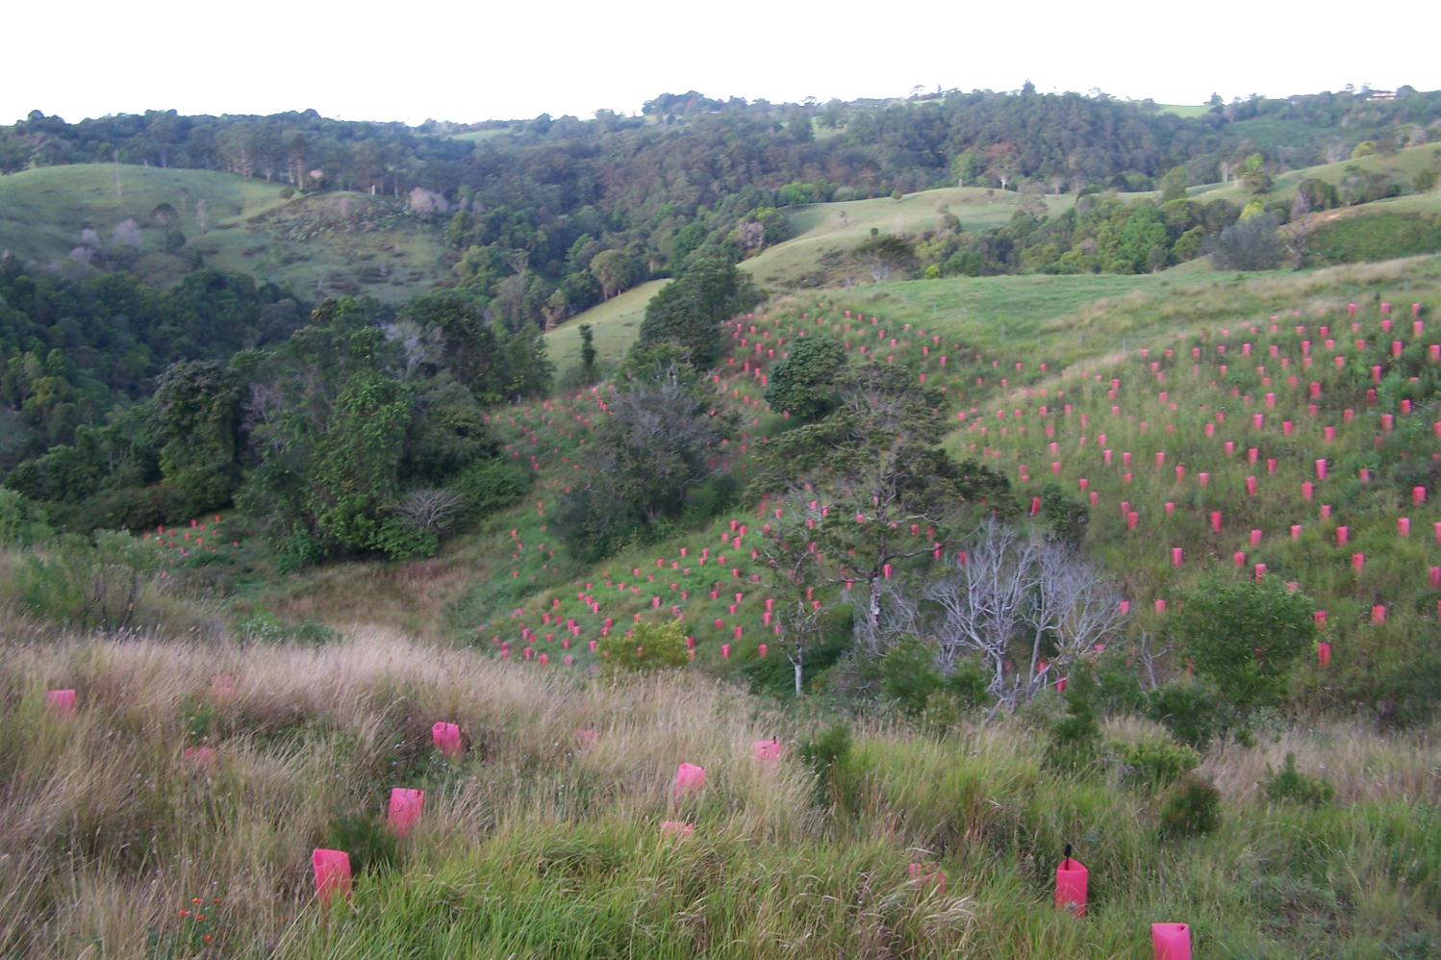
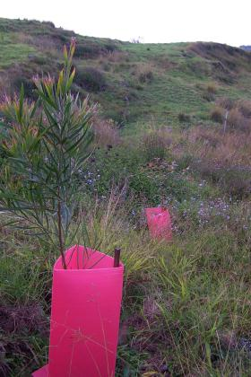
Projects – Upper Alcorn
Riparian Remediation
Project ends on June 30
Requires a final maintenance run – handover to landholder

Slide 9
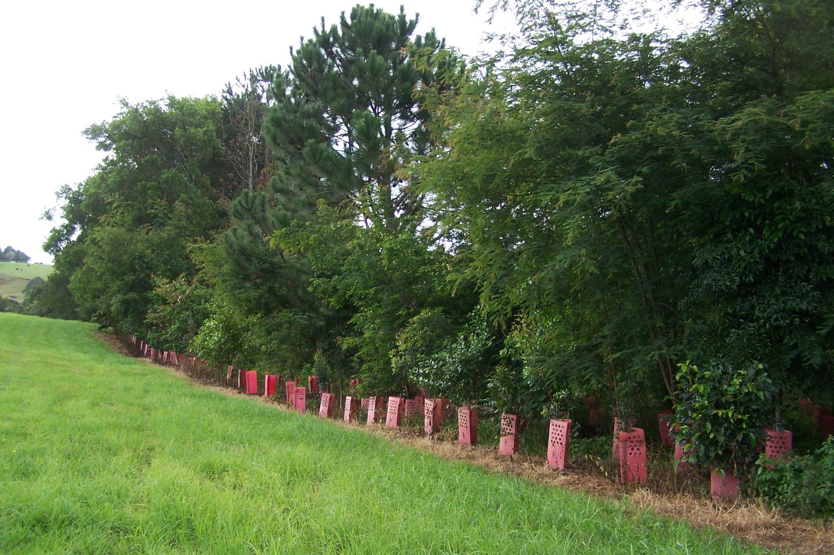
Projects – Upper Obi Obi Creek Restoration
Maintenance continuing
Focus on blue morning glory eradication

Slide 10
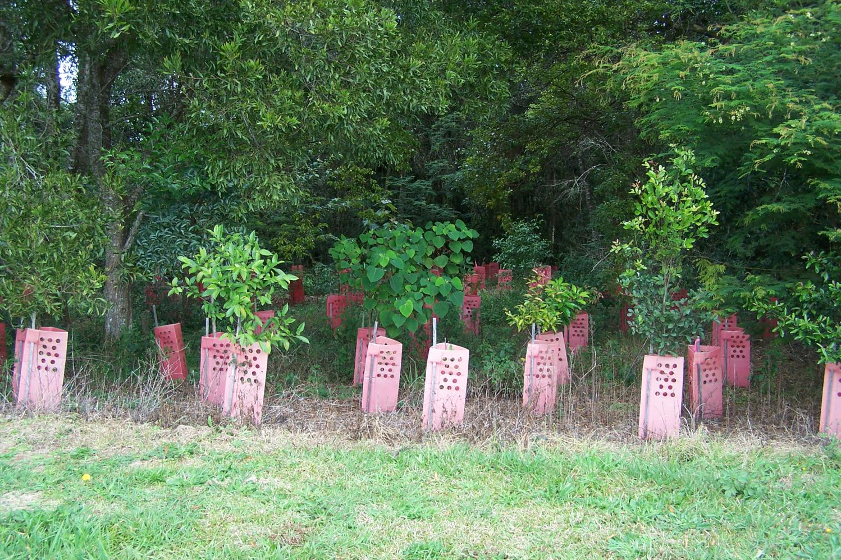
Projects –
Upper Obi Obi Creek Restoration
Project progressing well; majority of site on track for completion in mid 2015

Slide 11
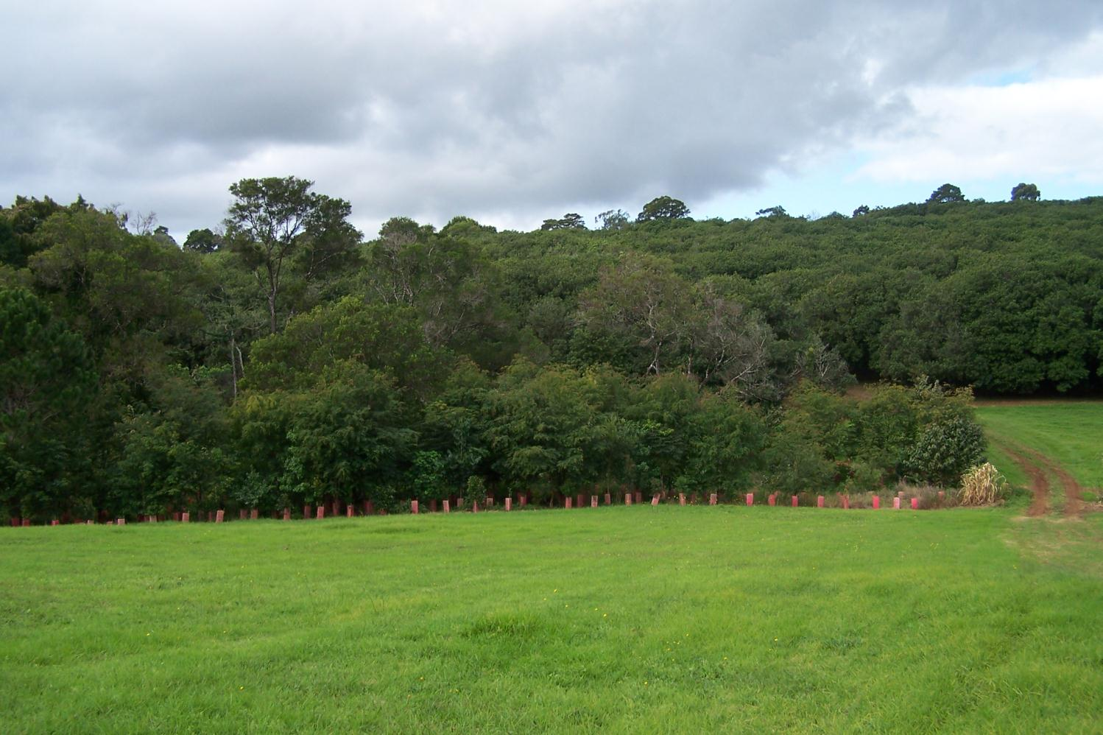
Projects –
Upper Obi Obi Creek Restoration
riparian buffer established between macadamia orchard and Kings Lane Weir

Slide 12
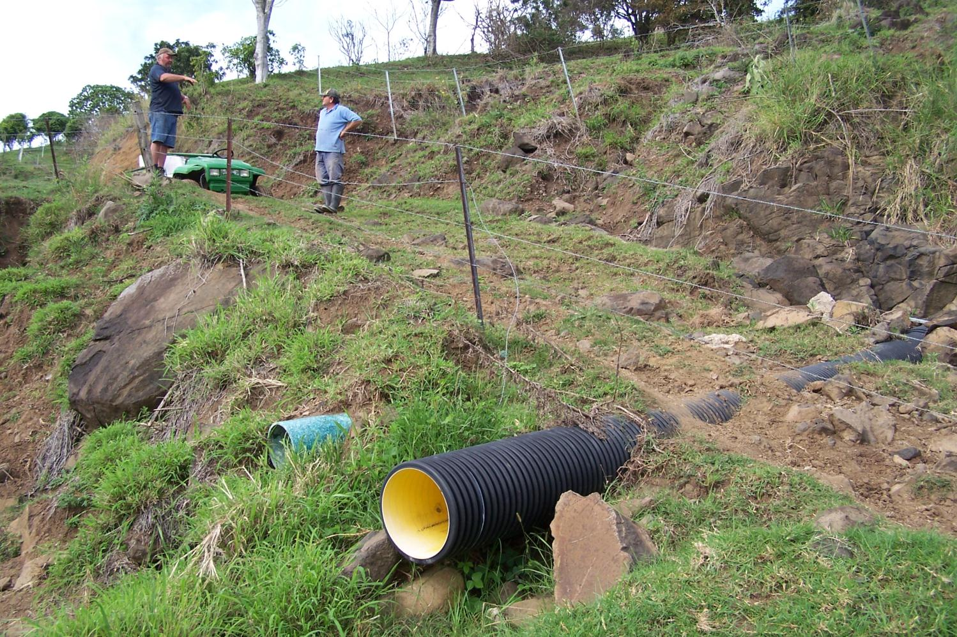
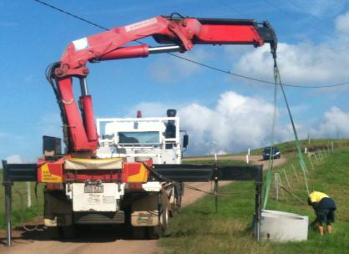
Projects – Wittacork
2013-14 Seqwater Landslide Support Program
Property road rehabilitation
Off stream watering

Slide 13
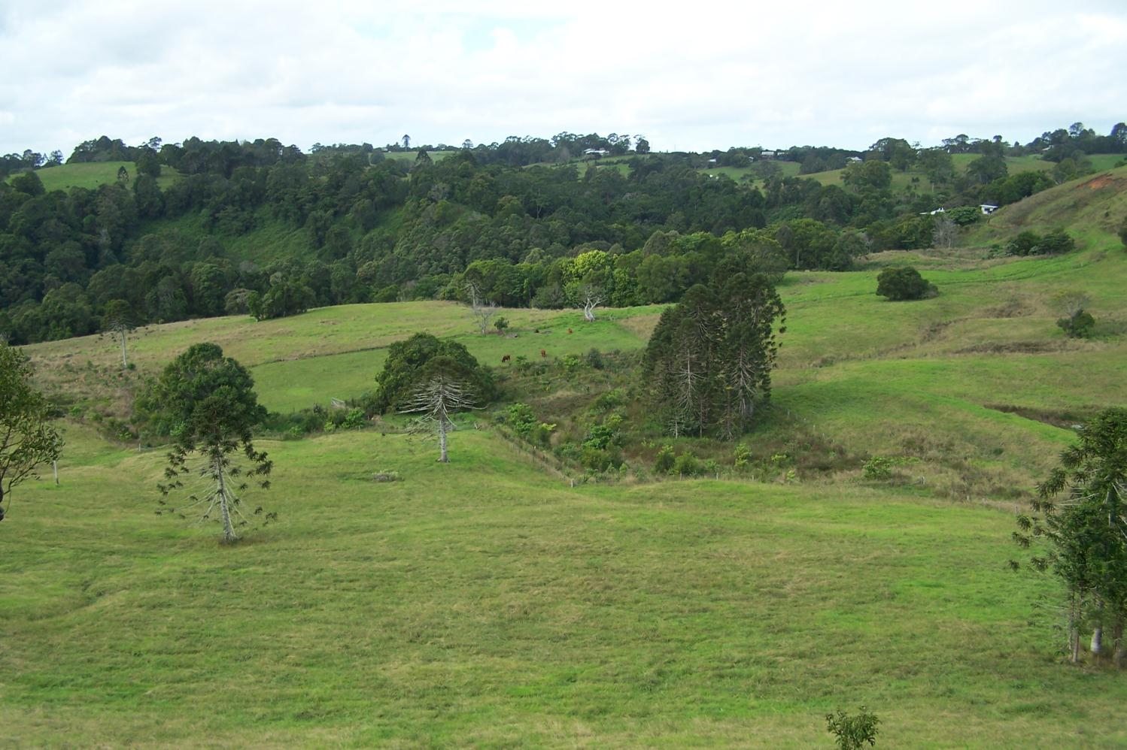
Projects – Restoring Bridge Creek
maintenance continuing

Slide 14
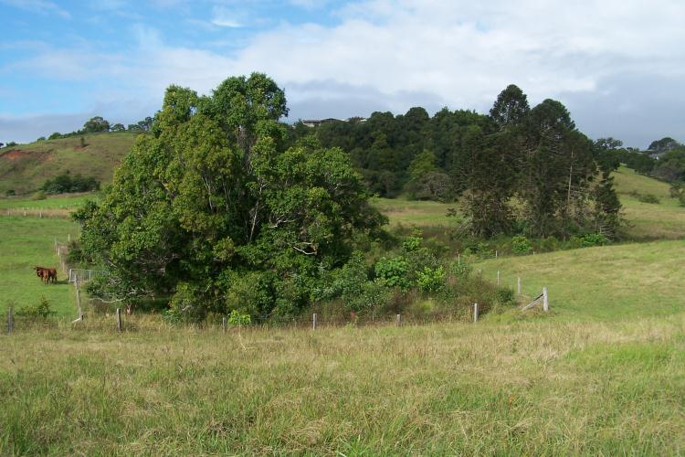
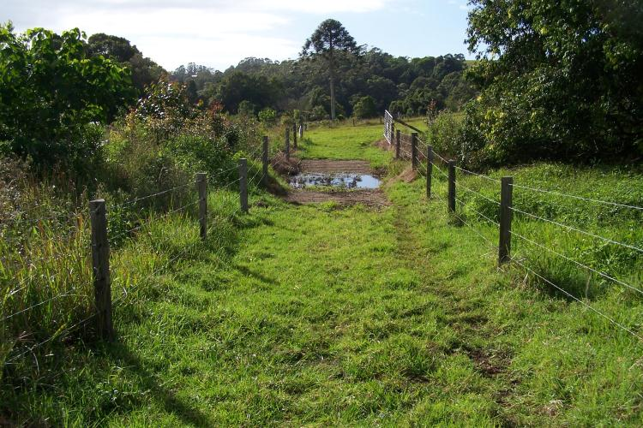
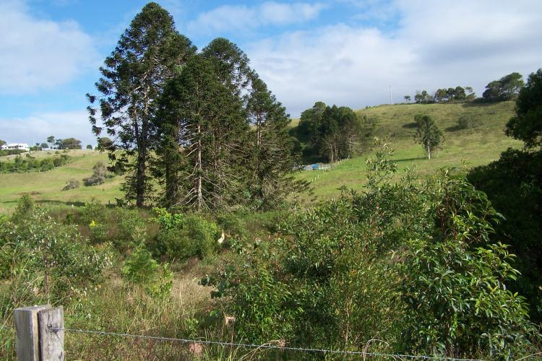
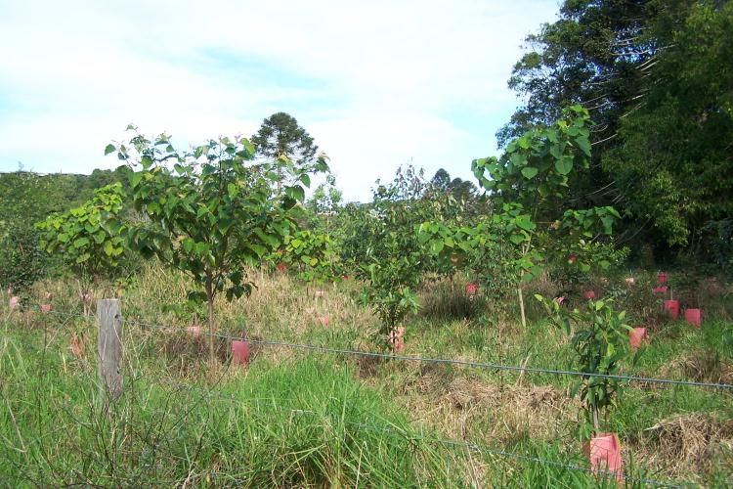
Reach 1 - Smith
Reach 1 – waterway crossing
Reach 1 - Smith
Reach 2 - Keton

Slide 15
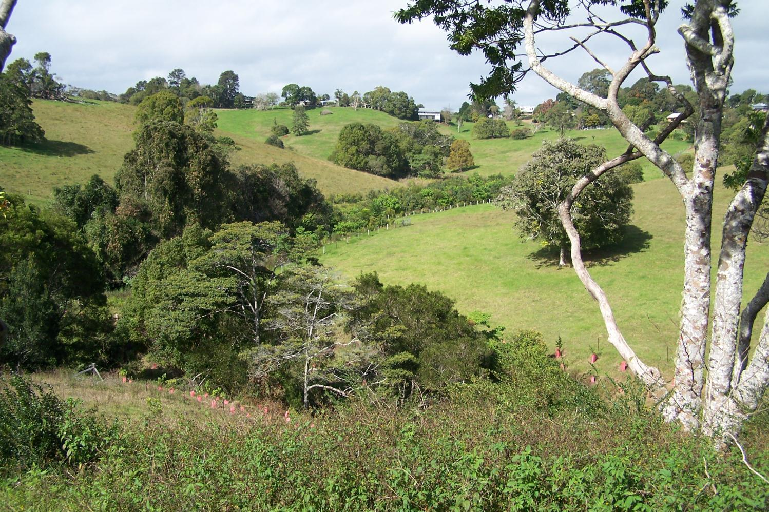
Projects – Upper Lawley Creek Restoration
maintenance continuing
Keton has a pending application to Sunshine Coast Council LEG grants to extend the project further

Slide 16
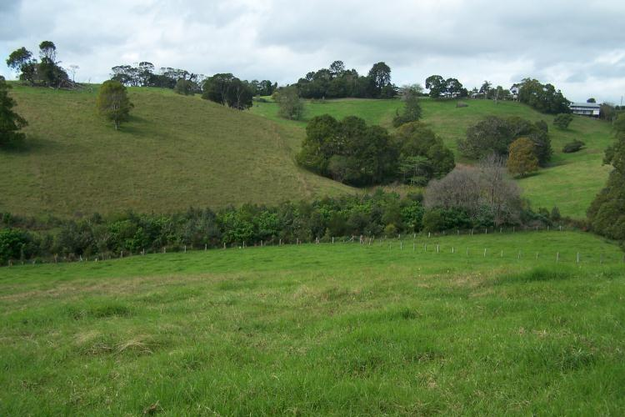
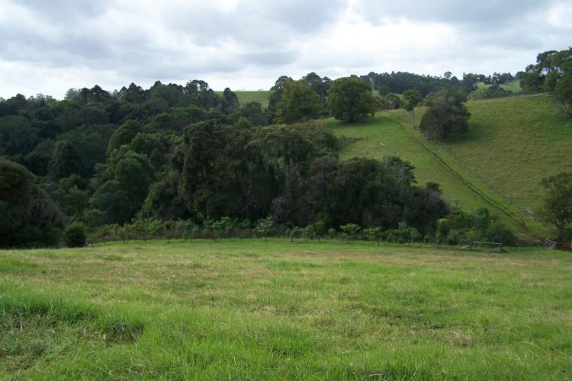
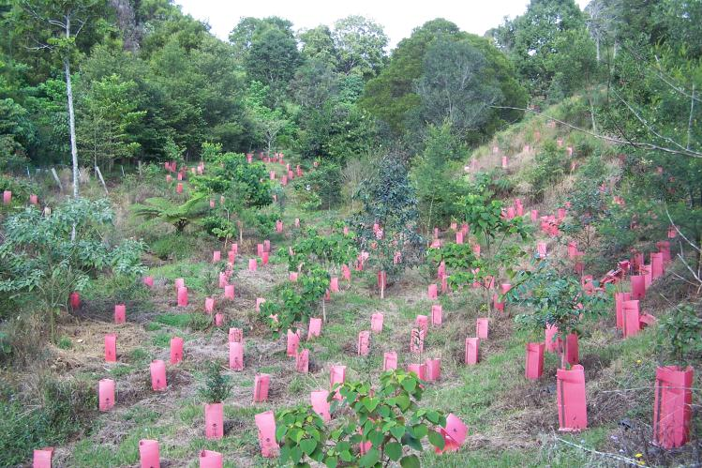
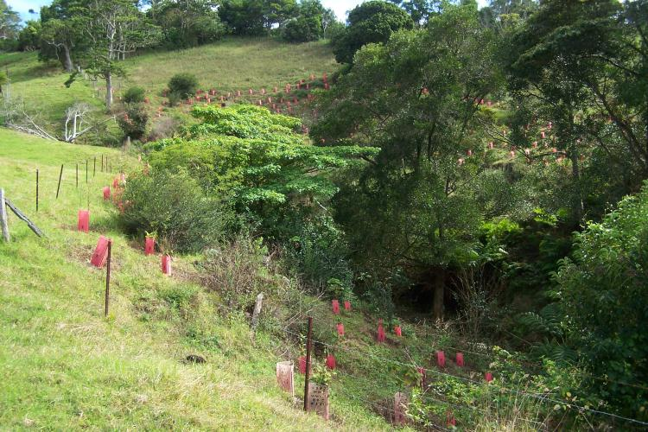
Reach 1 - Lawley
Reach 2 - Malter
Reach 3 - Keton
Reach 4 – Sunshine Coast Council project

Slide 17
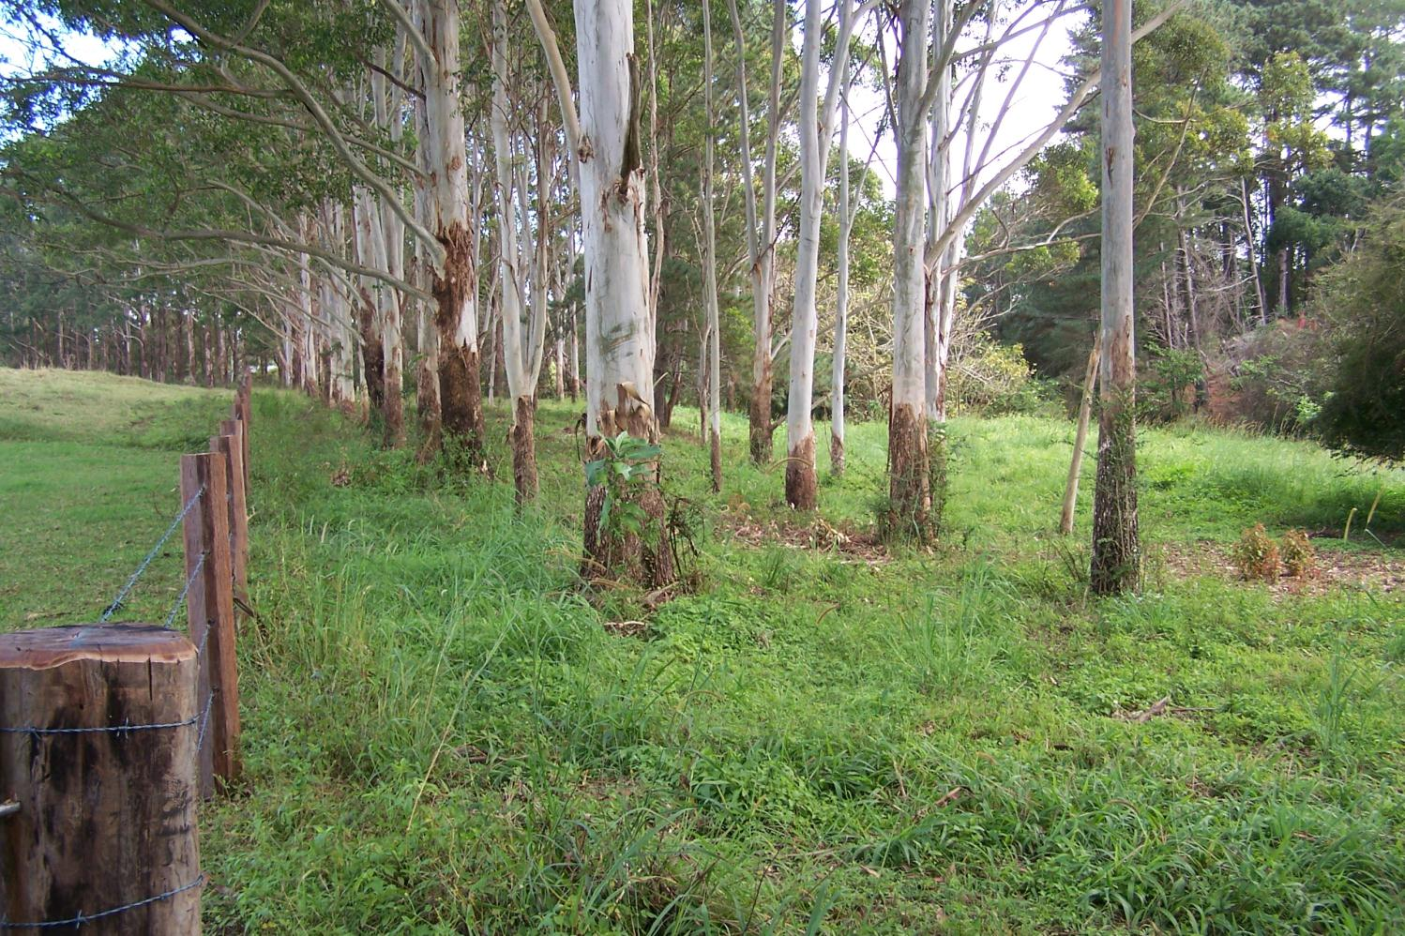
Projects –
Erowal Riparian Fencing & Off Stream Watering
Weed follow up commenced (spot spraying of environmental weeds)

Slide 18
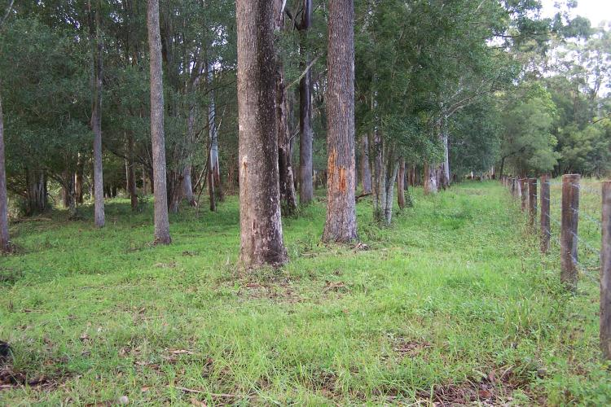
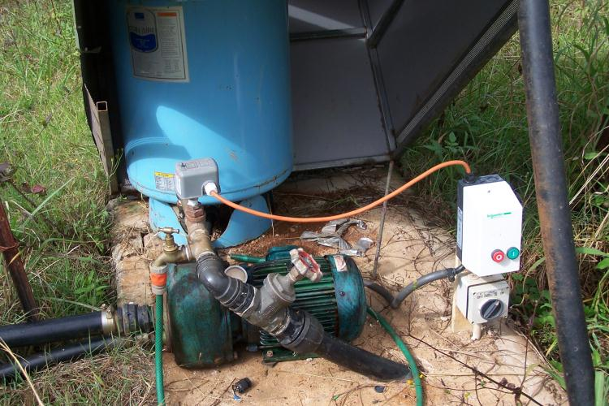
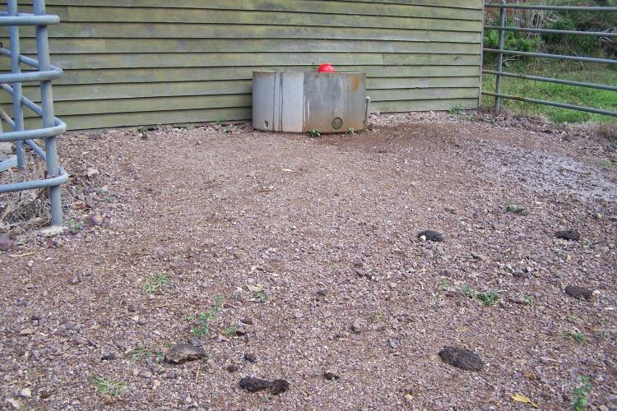
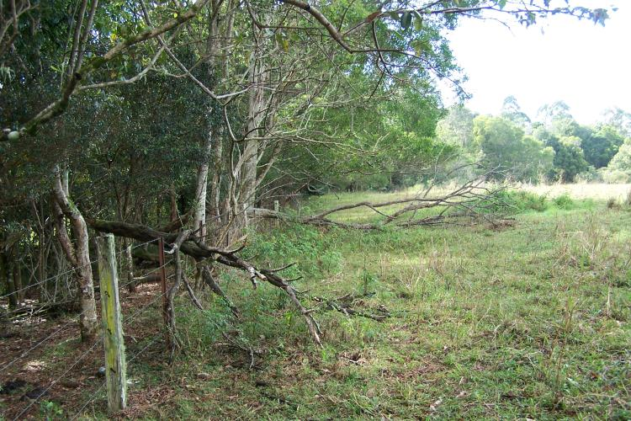
Posi-track mulching of weeds very successful (3 months on)
Erowal reconditioned pump/electrics
Roadbase settled nicely – trough needed minor adjustment
Wattles and fencing don’t mix

Slide 19
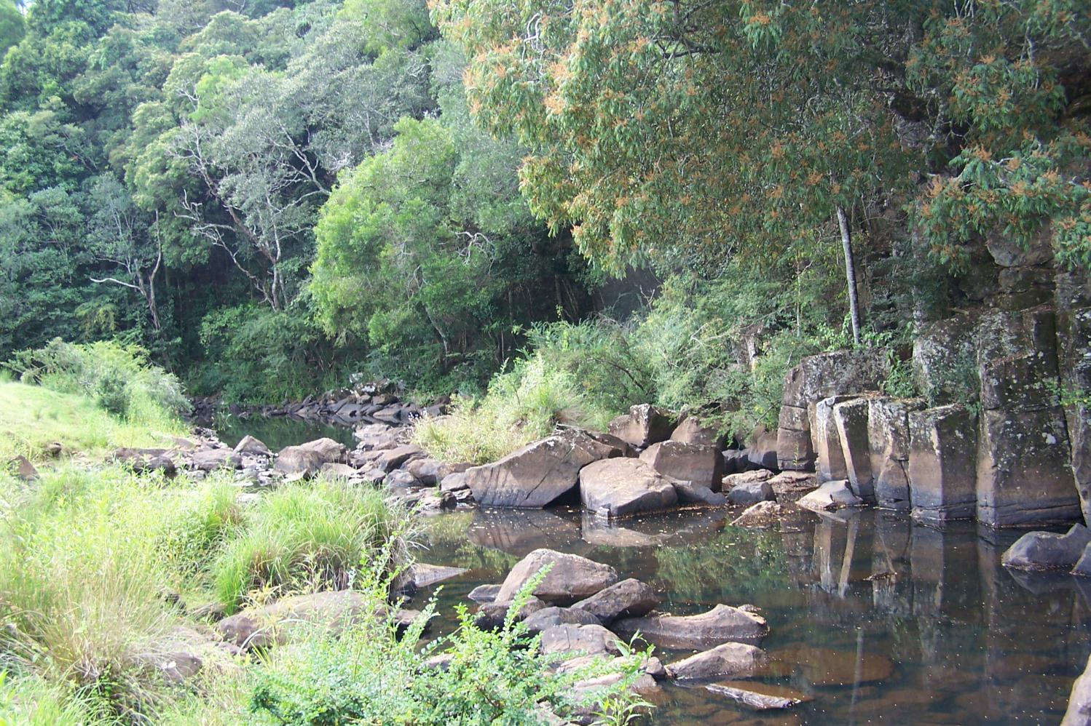
Projects –
Mid Obi Riparian Corridor
still waiting on Sunshine Coast Council Landholder Environment Grants
OSW materials ordered

Slide 20
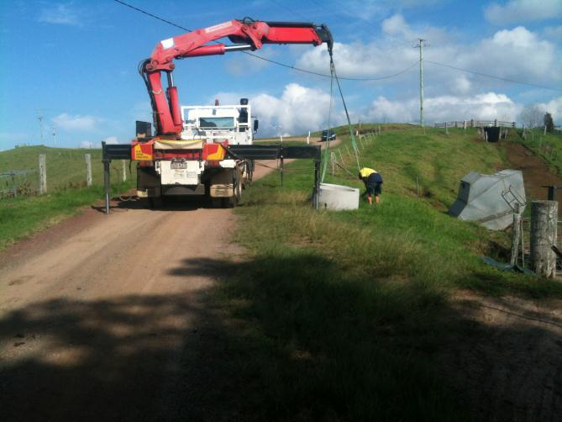
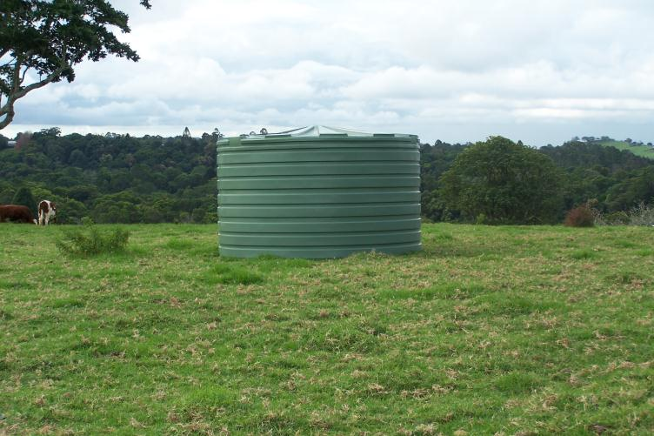
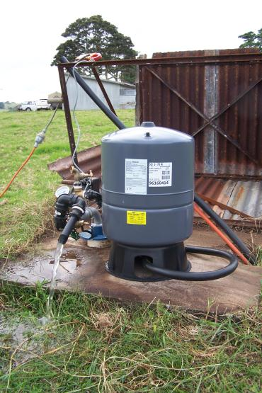
Troughs delivered 4/6/2014
5,000 gallon tank delivered 13/6/2014
Bore pump installed 19/6/2014
Waiting…(LEG grants)

Slide 21
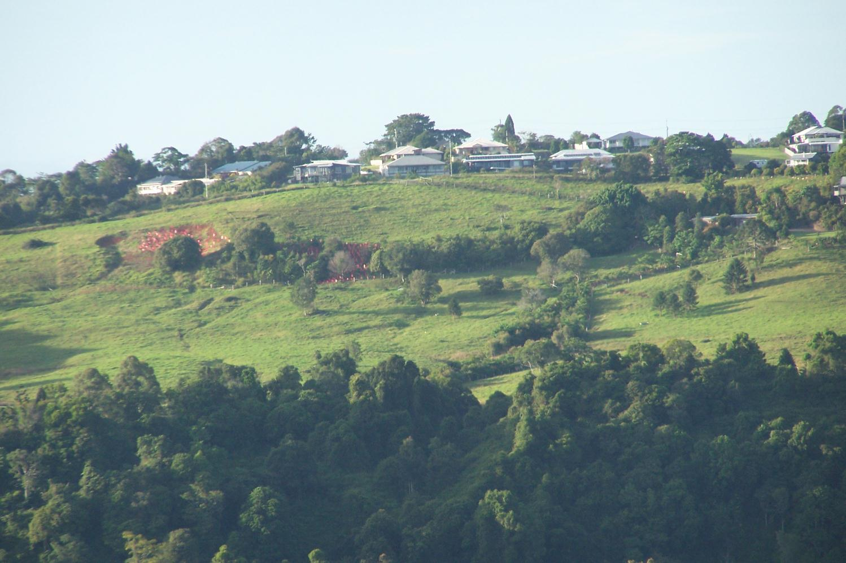
Other Projects – Watter slip
(Bridge Creek Rehabilitation)
Provided new (spare) Plant Pink tree guards (tubestock & fencing funds from SCC)
Provided access to old LBCCG project site to remove & reuse Plant Pink guards

Slide 22
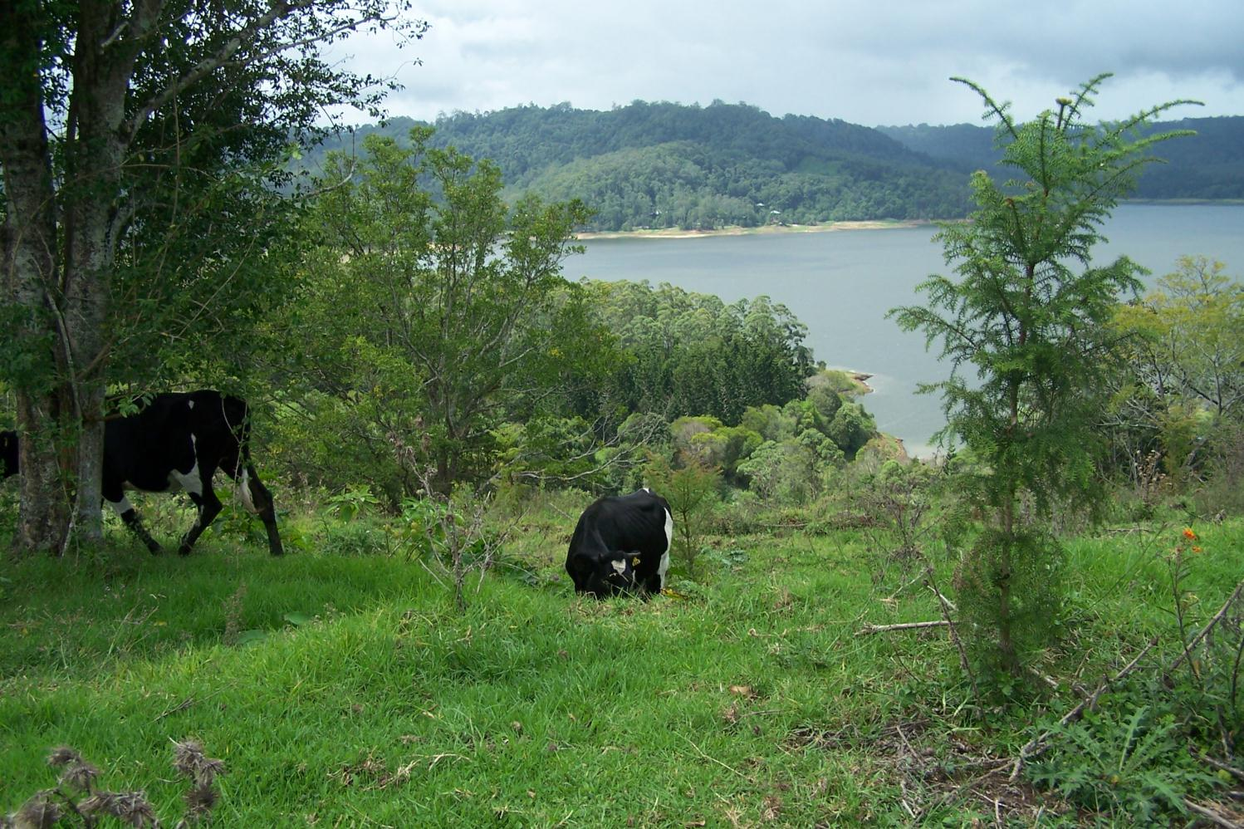
Other
Other Projects –
Seqwater Landslide Remediation Program
Coordinate the implementation of the project
Fee for service

Slide 23
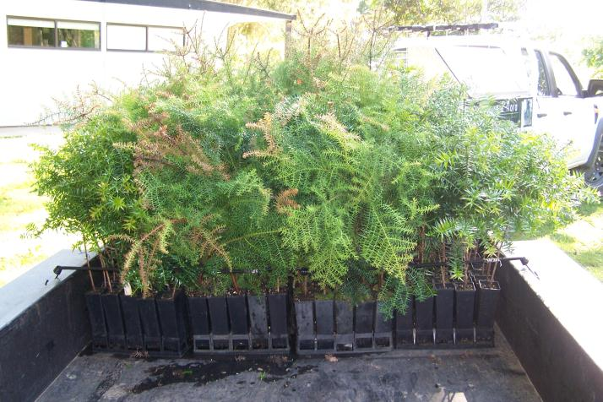
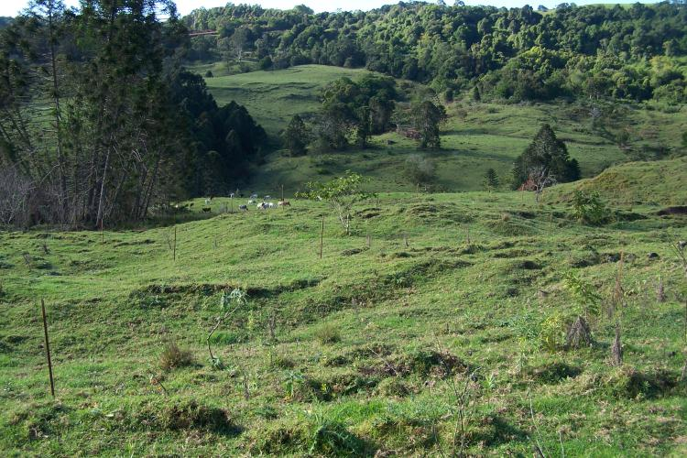
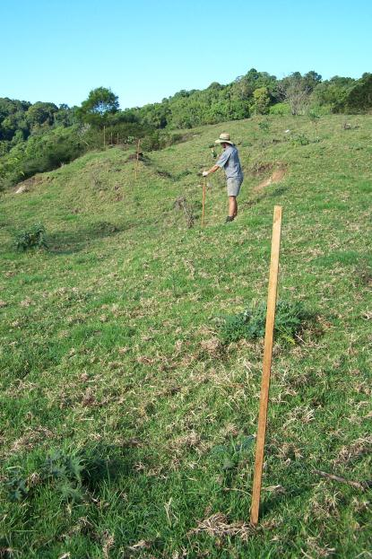
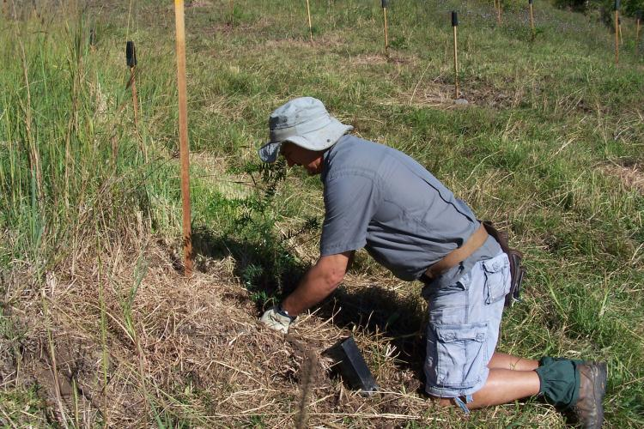
3,000 hoops/bunyas on 3 properties

Slide 24
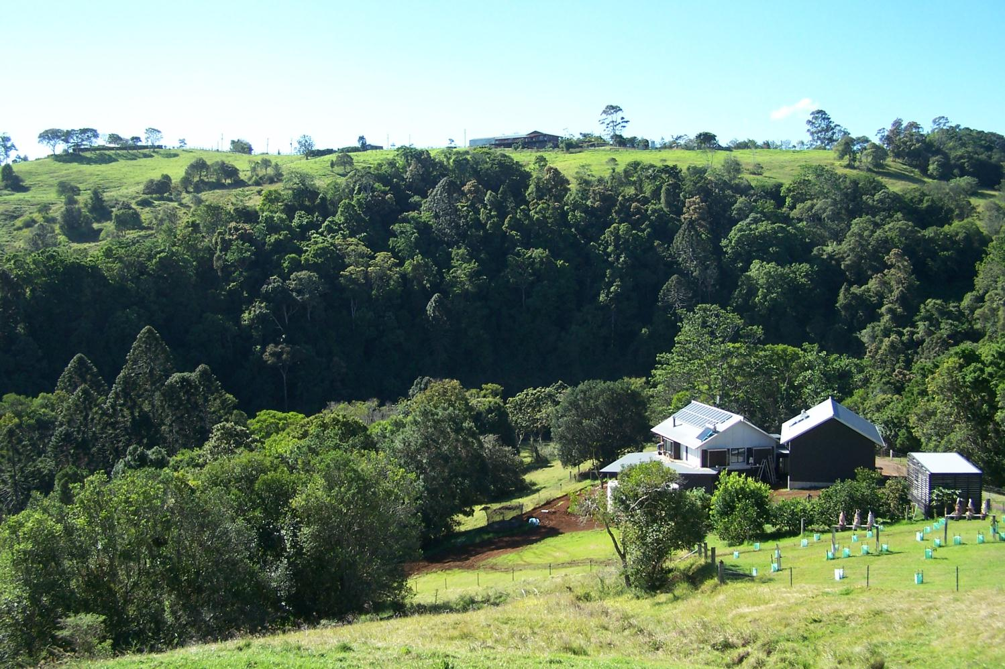
Project Development –
Nadi Lane/SCC Bushland Reserve
Investigating partnership with Council and adjacent landholders
to fence & revegetate riparian zone

Slide 25
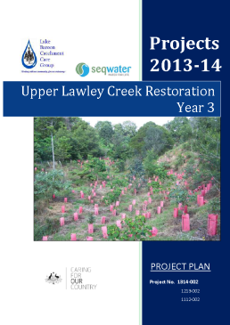
Project Development –
Upper Lawley Creek Restoration Year 3

Slide 26
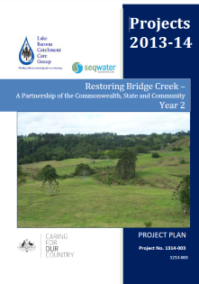
Project Development –
Restoring Bridge Creek Year 2

Slide 27
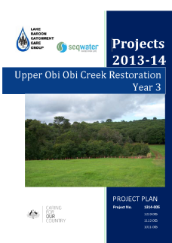
Project Development –
Upper Obi Obi Creek Restoration Year 3

Slide 28
